Slide 1
Python Analytics Presentation
Steven Chu
Edwin Aguilar

Slide 2
Table Of Contents
1. Question/Statement
2. Visualizations
3. Opportunities

Slide 3
Question/Statement
Original Question: I am looking to improve this year’s performance. What suggestions do you have for success?
Reframed Question: How can we use this year's performance to give detailed opportunities to increase the three pillars that define “success”. There are three indications of success, Profit, Longevity, Marketing.

Slide 4
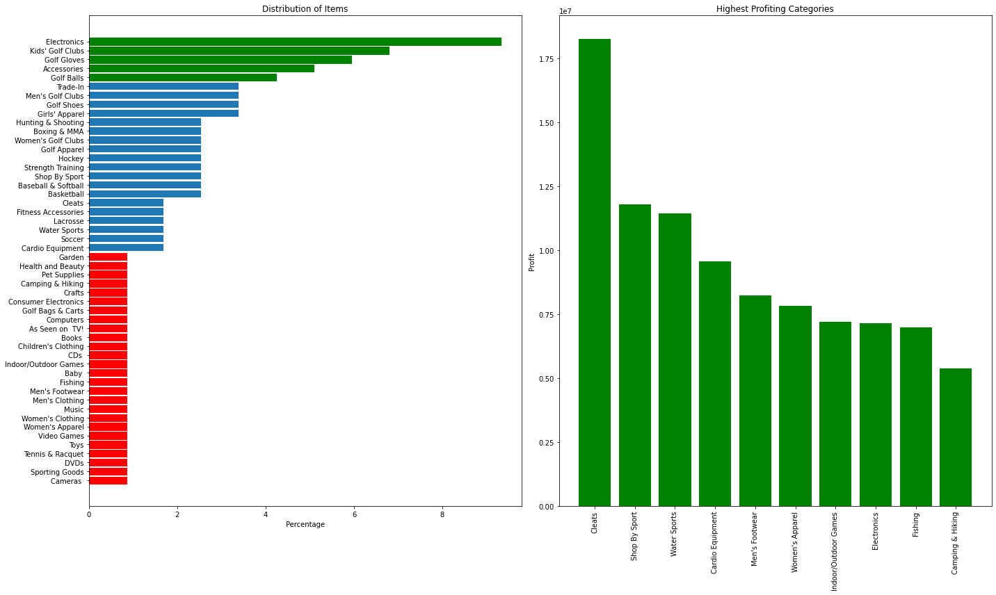
Visualizations
Two Graphs:
Production Distribution of Items
Highest Profiting Regions
Electronics highest distribution while being 7th place on the right chart

Slide 5
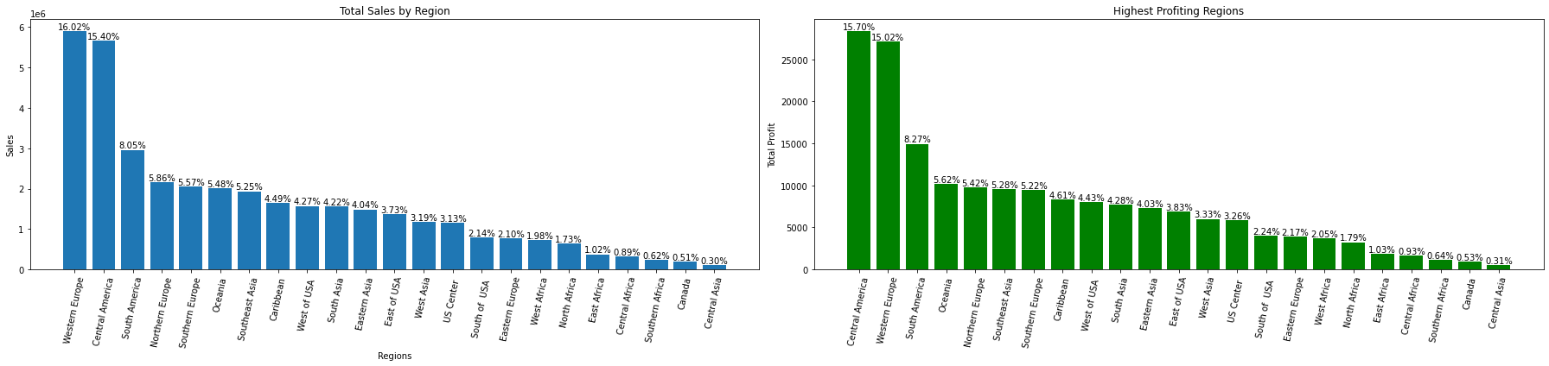
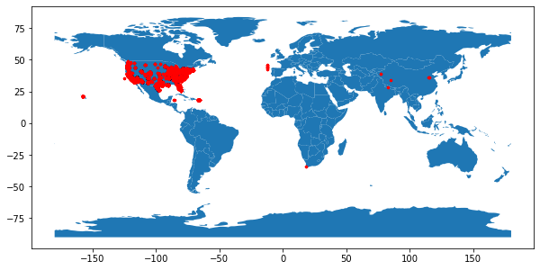
Cont. (Visualizations)
Highest sales: Western Europe. Highest Profit: Central America. Stores are concentrated within the U.S. so data is skewed in a sense where comparing Africa and Central America would create false conclusions.

Slide 6
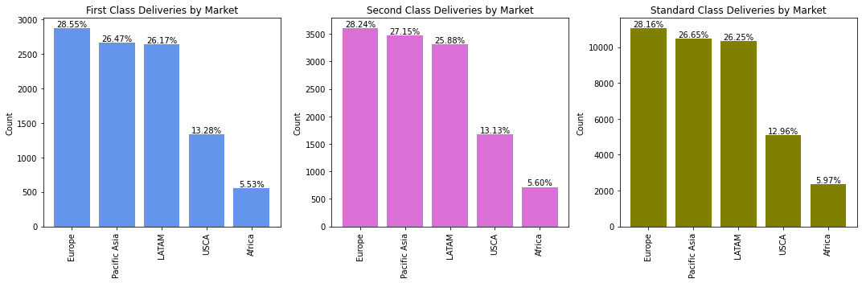
Cont. (Visualizations)
We can see the scale of each type of deliveries. Standard has the highest count followed by second, followed by first class.

Slide 7
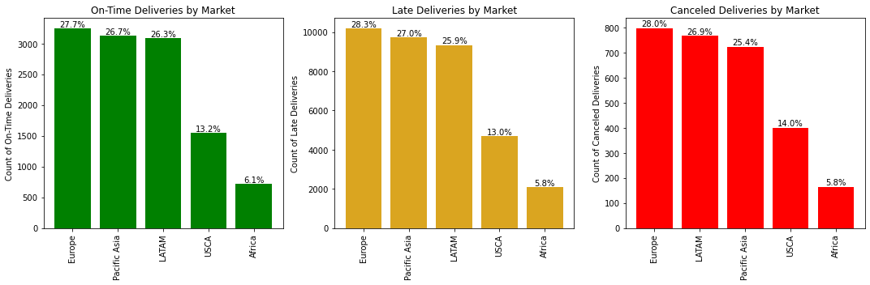
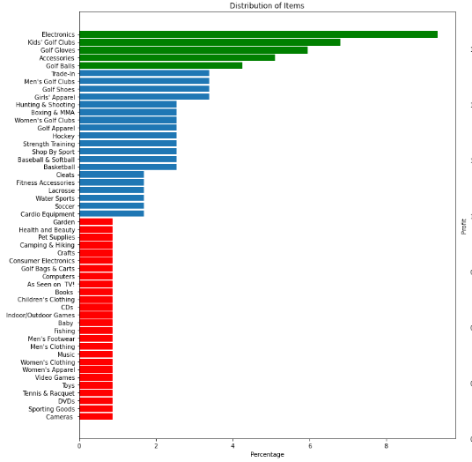
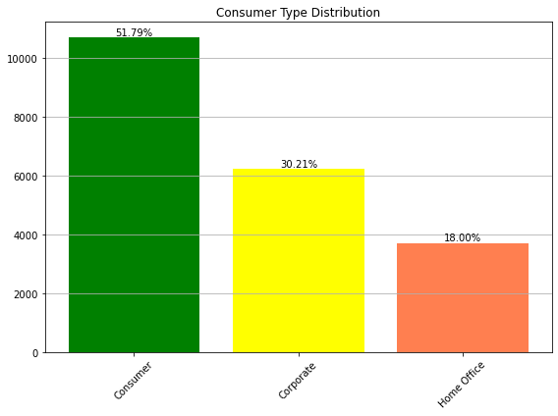
Improving the amount of on-time deliveries relative to late deliveries would show business reliability which would also improve customer retention. Not enough data was provided to figure out the cause of the delay.
Consumers over half of the distribution. Based on categories, data suggests purchases are primarily recreational.

Slide 8
Opportunities
Here are opportunities that will increase next years performance.
Focus on producing items in categories such as, Cleats, Shop By Sport, Water Sports, Cardio Equipment, Mens Footwear. The improper production distribution is limiting the profit potential. Categories high in production but low in profit will need to be reconsidered on the quantity they are produced.
Don’t necessarily remove stores in lowest profiting regions since the data is skewed due to the concentration of stores in other regions. Instead, set quotas for certain stores to ensure they are able to at the very least break even. If quota isn’t met, consider removing the stores. This could help with managing costs.
Unfortunately, not enough data was provided to figure out the cause of the abnormal delays. But, increasing the efficiency of the delivery process would improve customer retention.

Slide 9
Thank you

